Slide 1



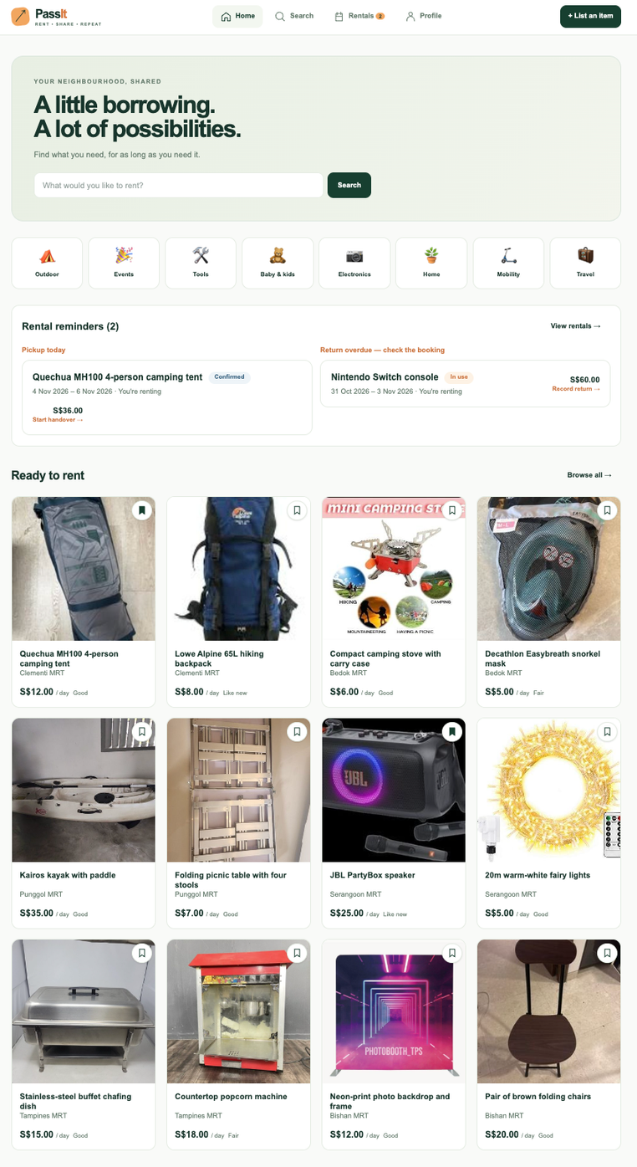
Borrow what you need from people nearby, and earn from things you already own.
PASSIT PRODUCT DEMO
Rent more. Own less.
Presented by
CS5224 Group 4
Ashley · Aviral · Kevin · Khushali · Prakhar · Punyaa
Notes:
Hello, we’re Group 4, and our project is PassIt — an island-wide peer-to-peer rental marketplace.
The idea is simple: instead of buying something you may only need once or twice, PassIt lets you borrow it from someone nearby. At the same time, people can earn from items they already own but rarely use.
So our goal with PassIt is to make access more convenient, reduce unnecessary ownership, and create value from items that would otherwise just sit idle.
Today, we’ll briefly introduce the problem we’re solving, show how PassIt addresses it, and then take you through a live demo of the platform.

Slide 2























PassIt
THE PROBLEM
Buy once, store forever?
Buy items for occasional use
Spend more
and store more
Idle items
earn nothing
buy
BORROW
buy
USE once
STORE
BORROW
USE
RETURN
higher cost TAKES SPACE
LOWER COST NO CLUTTER
Notes:
The problem we identified is that people often buy items for very occasional use — things like camping gear, cameras, or power tools.
That means they spend money on something they may only use once or a few times, and after that, it takes up storage space at home.
At the same time, there are already plenty of these items sitting unused in other people’s homes, but owners currently have limited ways to earn from them through a structured and trusted rental process.
Instead of the traditional cycle of buy, use once, and store, what if we let people borrow what they need and return it when they're done?

Slide 3

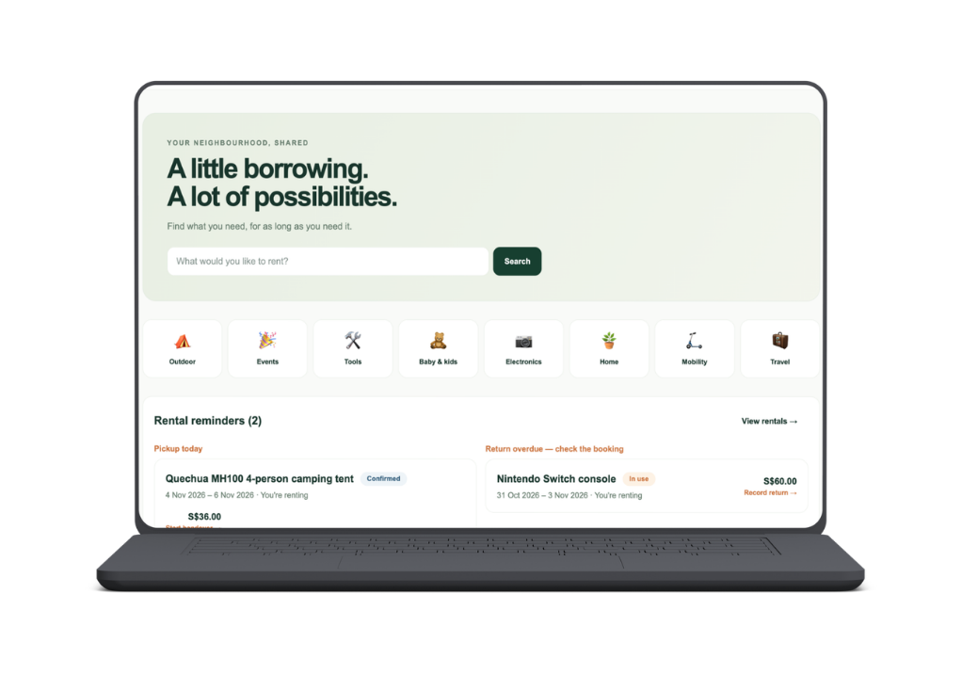





PassIt
WHY PASSIT?
Built for renting, not reselling.
Discover nearby
  Search by item, MRT & dates
RENT FLEXIBLY
  Day, week or month
RENT with confidence
  Deposit + condition evidence
earn from idle items
  List what you already own
Notes:
That's why we built PassIt.
PassIt helps connect people who need something for a short period of time with other people nearby who already own it.
- Say you need a projector for a weekend event. Instead of buying a new projector, you can search for rentals near your MRT, find competitive offers, and rent for only the period of time you need.
- For owners, it's an easy way to earn extra income from assets that would otherwise sit unused.

Slide 4






PassIt
FROM LISTING TO RENTAL
01
02
03
04
05
06
07
List
Price
Discover
Book
Handover
Return
Review
Add photos
  & details
Get AI price
  guidance
Search by
  item & location
Select dates
  & pay deposit
Meet, check &
  confirm condition
Check &
  complete return
Rate your
  experience
PASSIT SUPPOrts the full rental journey – not just item discovery.
Notes:
- Here's how rentals work from start to finish. The owner first creates a listing with photos and descriptions of their product.
- PassIt will suggest a rental price which the owner can edit.
- The renter finds the listing, selects their dates, and pays a deposit.
- When they meet for pickup, the app would record the projector's condition with a checklist and photos.
- When the item is returned, the condition will be checked and the deposit released.
- PassIt supports the full rental journey

Slide 5


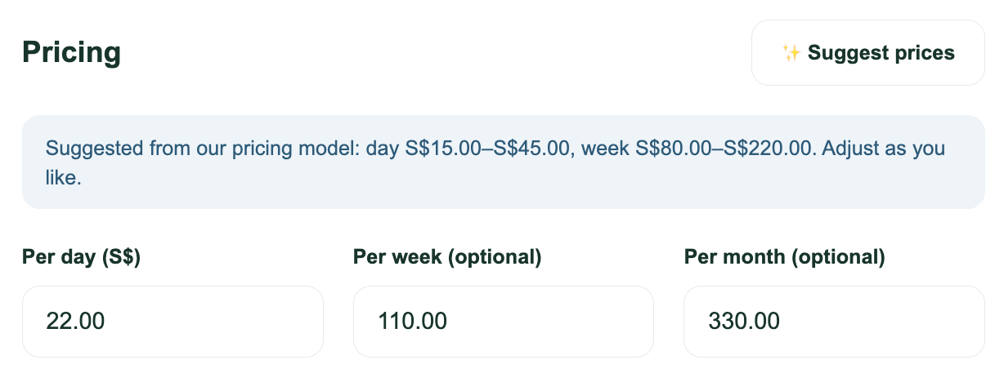
PassIt
SMARTER PRICING FOR LENDERS
AI-assisted,
human-controlled
01
understands the listing
  Item · Condition · Category
02
SUGGESTS A PRICE
  Per Day · Per Week · Per Month
03
KEEPS LENDERS IN CONTROL
  Suggestions stay editable

Slide 6




PassIt
FREE TO START.
perks for borrowers & lenders.
MOST POPULAR
ECO SAVER
PRIME SAVER
MEGA SAVER
S$0 · free forever
S$6.90 / month
S$12.90 / month
FOR BORROWERS
FOR BORROWERS
FOR BORROWERS
Rent any item
25% lower deposits
Zero deposits
Standard deposit
Free rescheduling
1 free delivery a month
Standard cancellation
Early access to listings
+1 day return grace
FOR LENDERS
FOR LENDERS
FOR LENDERS
Up to 3 listings
Up to 10 listings
Unlimited listings
0% commission
Payouts in 3 days
Same-day payouts
AI price suggestions
Prime badge on listings
Boosted in search
0% COMMISSION. Plus perks are funded by PassIt.

Slide 7
PassIt
WHEN LOAD INCREASES, PASSIT SCALES OUT
How it scales
Tested on AWS
• Pages and photos served from the edge
Surge 20 → 150 users
• Stateless API: any copy serves any request
0.04% errors, 3rd copy added automatically
• Autoscaling: 2 to 6 copies, CPU kept at 60%
Kill 1 of 2 API copies
0 failed requests
• Slow work (thumbnails, emails) runs on events
auto-scales 2 to 6
Users
CloudFront
ALB
Stateless API on Fargate
copies ×2 to 6
PostgreSQL (RDS)
S3 photos and thumbnails
SNS / EventBridge → Lambda
Notes:
Our product is built so that when load goes up, nothing needs to change. The API keeps no state, so any copy can serve any request, and new copies join behind the load balancer straight away. Autoscaling watches CPU and keeps it around 60 percent, running between 2 and 6 copies. Pages and photos come from CloudFront and S3, so they never touch the API. Slow jobs like thumbnails, emails and releasing rental fees run on events in the background, so a rush of bookings does not slow page loads. We load-tested this on AWS. With a surge from 20 to 150 users, errors stayed at 0.04 percent and a third copy was added automatically. When we killed one of two servers mid-test, no requests failed.

Slide 8
PassIt
WHAT BREAKS FIRST, AND WHAT IT COSTS
What breaks first
Prototype (built)
Implemented
10× launch
Designed, not built
100× growth
Designed, not built
1
Database connections → RDS Proxy
Users
~150
~1,500
~15,000
2
API
2 to 6 copies
4 to 20 copies
More, larger copies
Database CPU → bigger database
Database
Small DB
Bigger DB + RDS Proxy
Aurora + read replicas
3
Free-text search → trigram index
Est. cost
/ month
~USD 90
~USD 350 to 450
USD 1,500+
4
Slow scale-out (5 to 7 min) → pre-scale
Expected surge: pre-scale on a schedule
Extra API copy: ~USD 0.017 / hour
Unexpected surge: autoscale, slower but no failures
A 1-hour surge costs ~7 cents
Abusive traffic: WAF rate limiting
The database is the main cost step
Estimated from AWS on-demand prices for ap-southeast-1 (Singapore), excluding data transfer.
Notes:
So what happens if usage keeps growing? The first thing to hit a limit is the database. Each API copy opens up to 30 connections, so scaling out would run out of connections before CPU, and RDS Proxy is the first fix. After that comes database CPU, free-text search, and the 5 to 7 minutes autoscaling needs to react. For surges we can predict, like the start of term, we scale up beforehand. For unexpected surges, pages slow briefly but keep working, and a WAF handles abusive traffic. On cost, the prototype is about 90 US dollars a month. At 10 times the users it is roughly 350 to 450, and at 100 times, 1,500 or more. Extra API copies cost only cents per hour, a one-hour surge is about 7 cents, so the database is the main cost step.

Slide 9
PassIt
PRODUCT DEMO
BORROWER • LENDER
Notes:
Hello, we’re Group 4, and our project is PassIt — an island-wide peer-to-peer rental marketplace.
The idea is simple: instead of buying something you may only need once or twice, PassIt lets you borrow it from someone nearby. At the same time, people can earn from items they already own but rarely use.
So our goal with PassIt is to make access more convenient, reduce unnecessary ownership, and create value from items that would otherwise just sit idle.
Today, we’ll briefly introduce the problem we’re solving, show how PassIt addresses it, and then take you through a live demo of the platform.

Slide 10



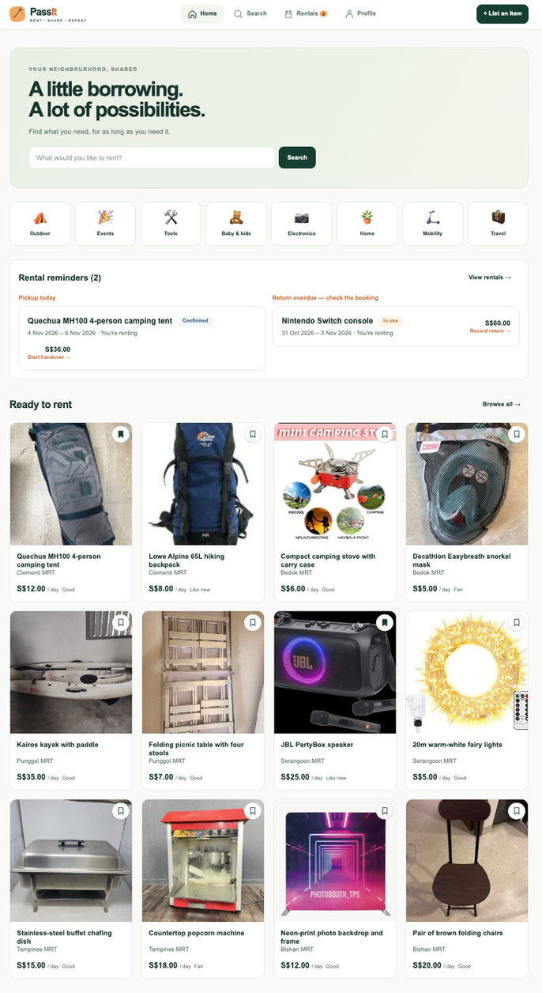




PassIt
THANK YOU
Rent more. Own less.
Questions welcome.
d2qlmvfhlu3k82.cloudfront.net
github.com/punyaa/PassIt
Demo: seed-02@passit.demo · passit-demo-2026

Slide 11


PassIt
HOW IT RUNS ON AWS
Backup · for Q&A
USERS
Browser & phone
CLOUDFRONT
HTTPS · global CDN
caches photos
LOAD BALANCER
Routes traffic
ECS FARGATE
Next.js web + FastAPI API
auto-scales 2 → 6 tasks
no servers to manage
POSTGRESQL 16
Amazon RDS · private
no-overlap constraint
HTTPS
photos via CDN
price hints
events & jobs
S3 PHOTO STORAGE
Direct uploads ·
auto thumbnails
BACKGROUND JOBS
EventBridge → Lambda: fee release
SNS → Lambda → SES: email alerts
AI PRICING
NUS LLM service,
falls back to median rule
CI/CD GitHub Actions → ECS, no stored AWS keys
Infra as code Terraform
Monitoring CloudWatch alarms

